Slide 1
AN ANALYTICAL STUDY ON THE PHYSICO-CHEMICAL CHARACTERISTICS OF GROUND WATER IN VIJAYAWADA BY USING GIS AND ITS SUITABILITY.
UNDER THE GUIDANCE OF
DR. A. ADI LAKSHMI

Slide 2
Teammates
We are,
K. Sai Anand Vardhan - 18501A0125
K. Chandrasekhar - 18501A0123
L. Srinivasa Rao - 18501A0127
L.V.S.S. Kishore - 18501A0128

Slide 3
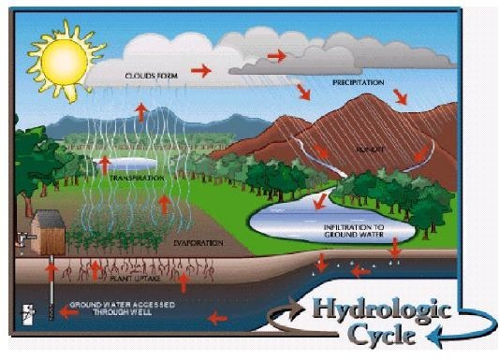
Ground Water
IT’S SIGNIFICANCE
Groundwater is the source of about 90% of the country’s drinking water. In rural areas, almost all the water supply comes from groundwater and more than one-third of our 100 largest cities depend on it for at least part of their supply. Historically, groundwater has been considered to be safe to drink.
OUR NEED
Hence there is a need to assess the quality of ground water. Water-quality monitoring is used to alert us to current, ongoing and emerging problems; to determine compliance with drinking water standards, and to protect other beneficial uses of water.

Slide 4
Intent
1

Slide 5
INTENT
To find the integrity of ground water of our Vijayawada city.
To identify places with unpleasant ground water.
To find the causes of ground water pollution.
To find ways for avoiding contamination of ground water.
To formulate remedies with unusable ground water and consequences if used.

Slide 6
Strategy
2

Slide 7
STRATEGY
Preparation of thematic maps using Survey of India toposheet and satellite imagery using ARCGIS 10.8.1 Software.
Collection of ground water samples at different locations.
Testing the quality of ground water samples of different locations.
Evaluation of quality of ground water samples with respect to the IS 10500 : 2012 standards.
Preparation of spatial distribution of ground water maps using GIS Platform.

Slide 8
Execution
3

Slide 9
EXECUTION
Study Area Selection
Sample Collection
Sample Analysis

Slide 10
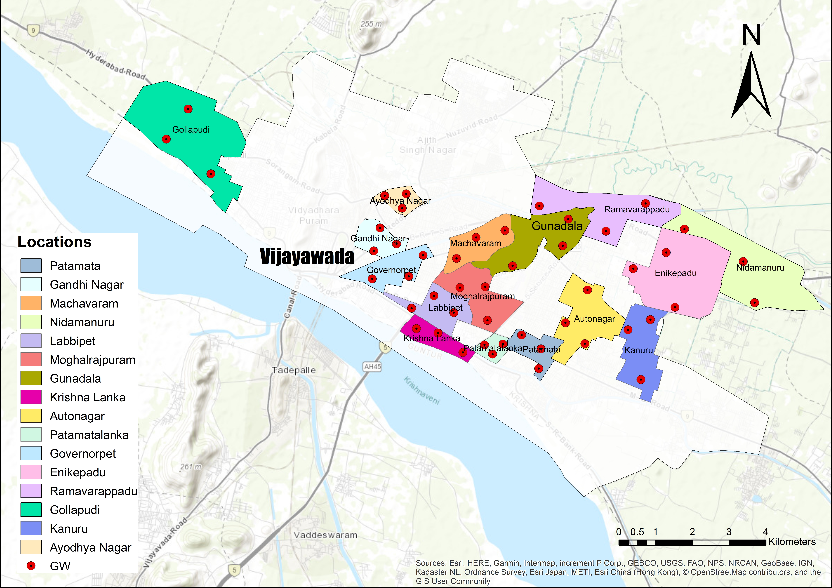
EXECUTION

Slide 11
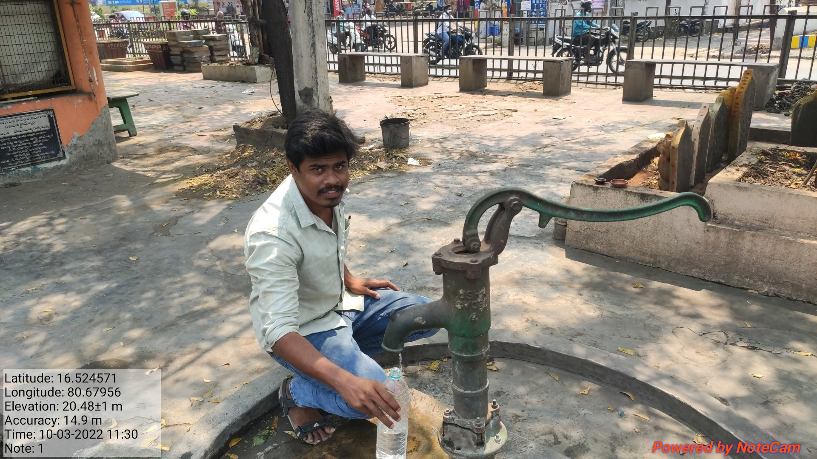
Sample Collection

Slide 12
Sample Parameters
Physical
Turbidity
Total Solids, TSS & TDS
Colour
Odour
Taste
Chemical
Ph
Alkalinity
EC
Hardness (Ca, Mg, Permanent, Temp.)
Chlorine Content
Ca
Mg
SO4

Slide 13
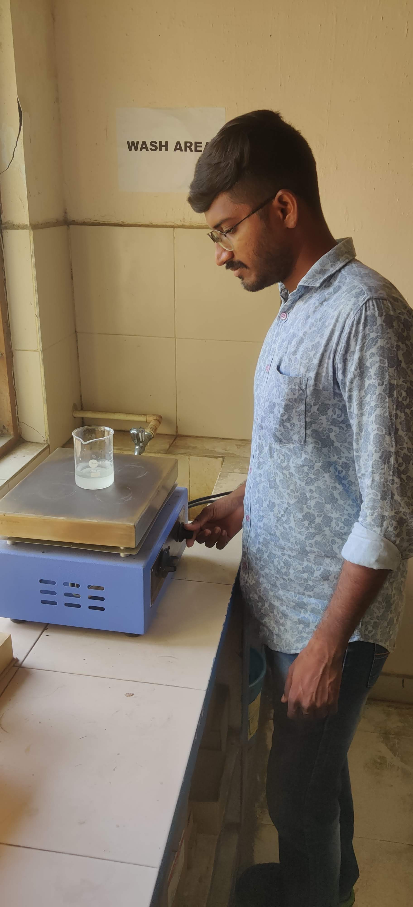
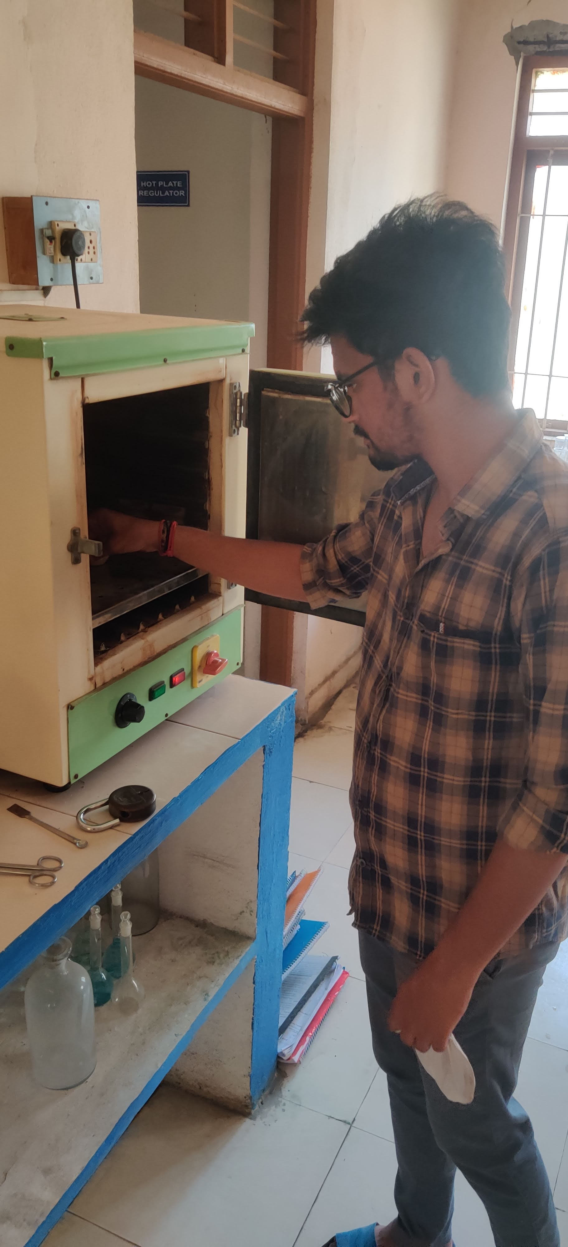
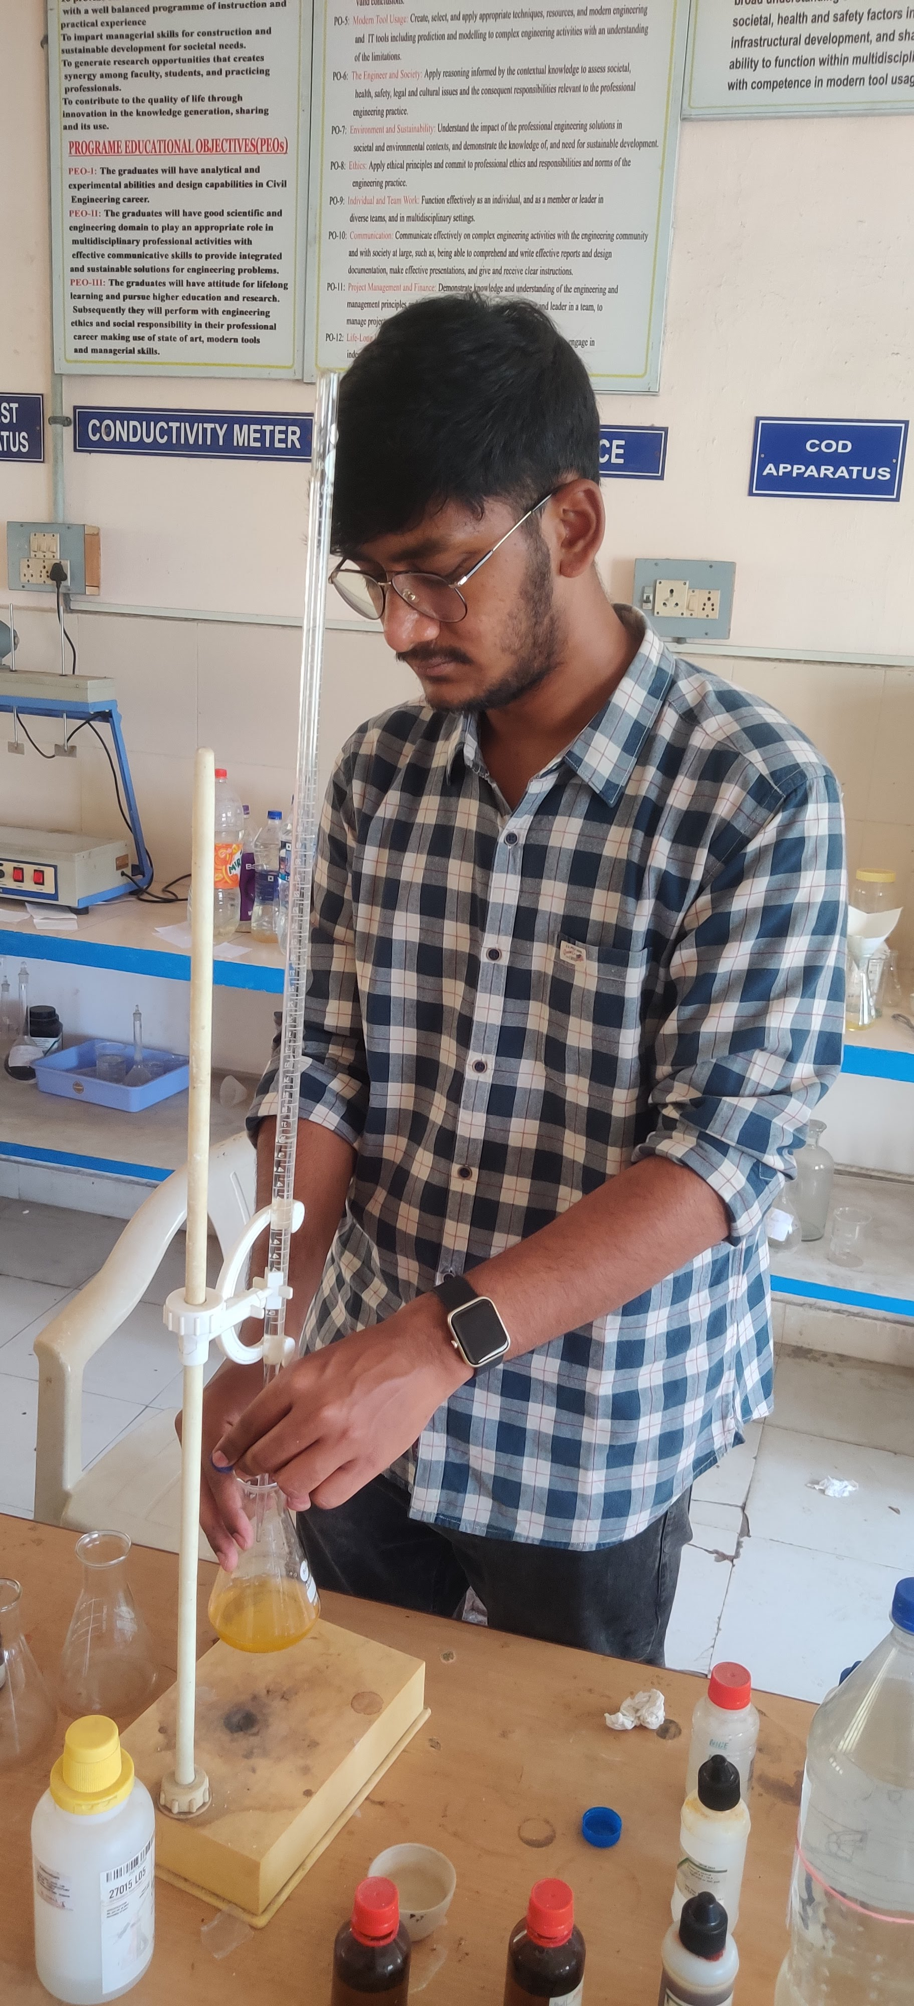
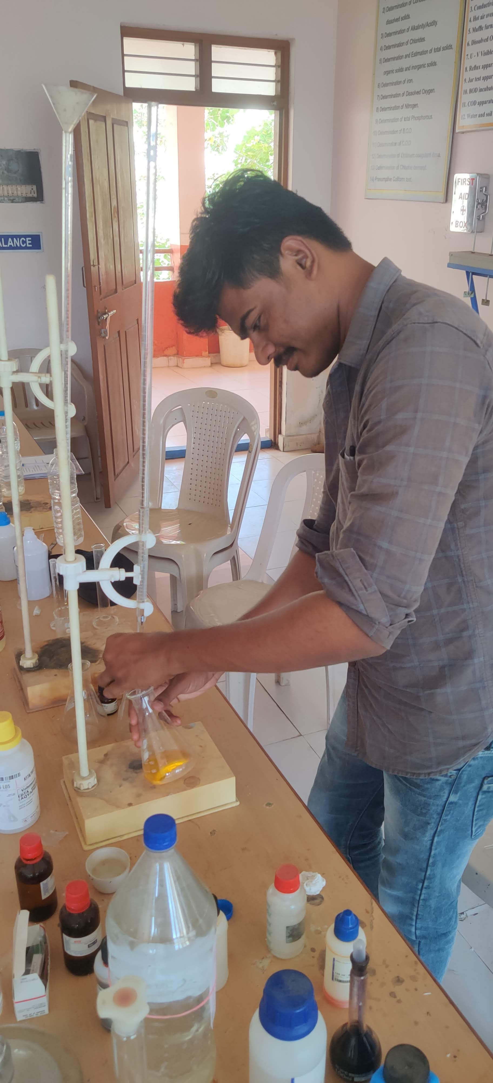

Slide 14
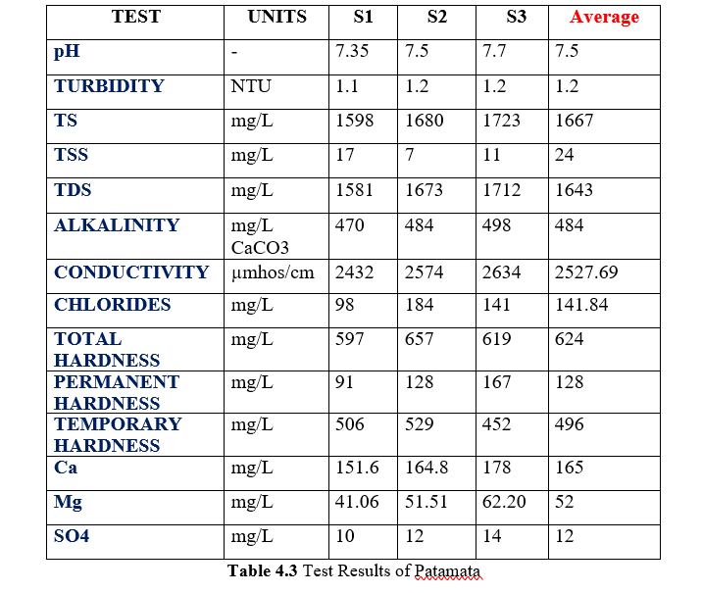
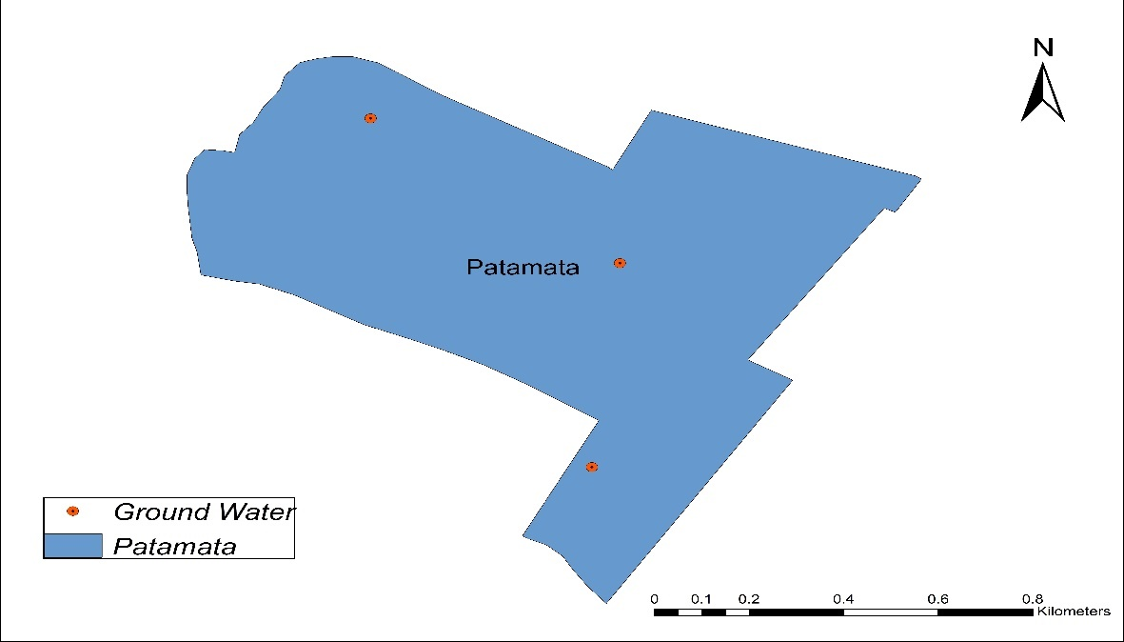
Sample Results Example

Slide 15
WATER QUALITY PARAMETERS AND STANDARDS FOR VARIOUS PHYSICAL AND CHEMICAL CONSTITUENTS
S.No. | Parameters | IS 10500: 2012, WHO
 |  | Permissible Limit | Maximum Limit
1 | Colour | Agreeable | Agreeable
2 | Odour | Agreeable | Agreeable
3 | Taste | Agreeable | Agreeable
4 | pH | 6.5 to 8.5 | No relaxation
5 | Turbidity (NTU) | 1 | 5
6 | Alkalinity (as CaCO3) (mg/L) | 200 | 600
7 | Electrical Conductivity (μmhos/cm) | 500 | 1500
8 | TDS (mg/L) | 500 | 2000
9 | Chloride (mg/L) | 250 | 1000
10 | Hardness (as CaCO3) (mg/L) | 200 | 600
11 | Calcium (as Ca) mg/L | 250 | 1000
12 | Magnesium (as Mg) mg/L | 30 | 100
13 | Sulphate (mg/L) | 200 | 400

Slide 16
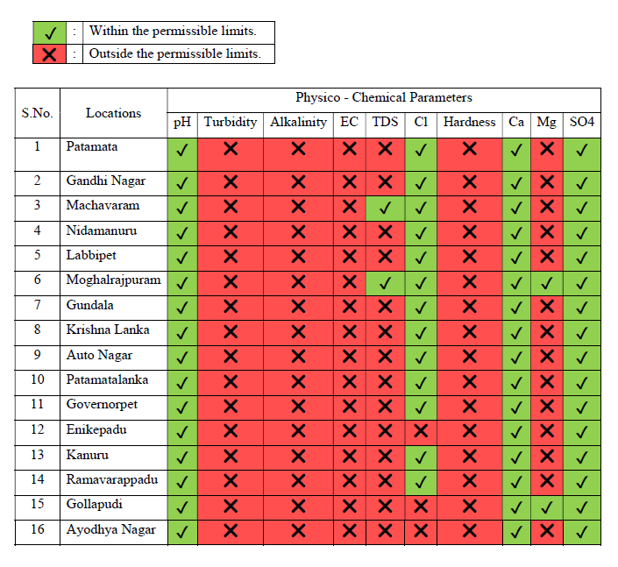
EVALUATION OF WATER QUALITY PARAMETERS OF WATER QUALITY PARAMETERS WITH PERMISSIBLE LIMITS:

Slide 17
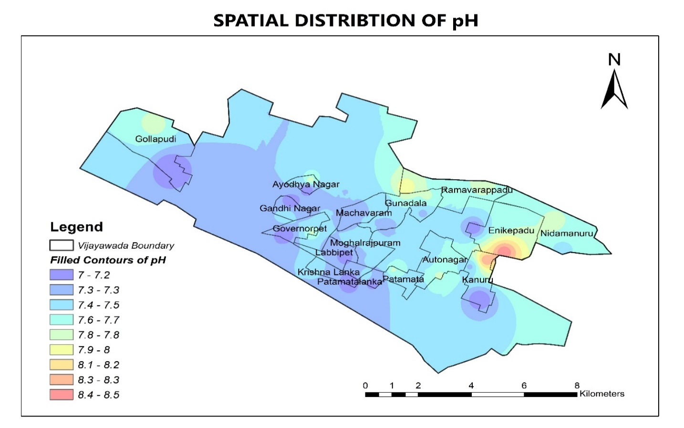
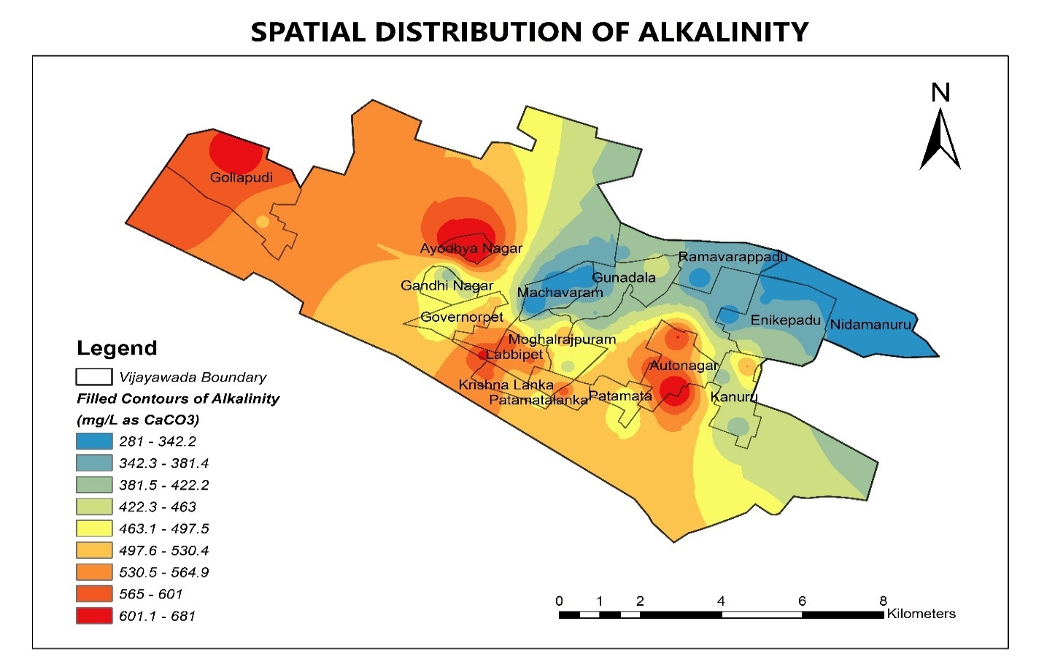

Slide 18
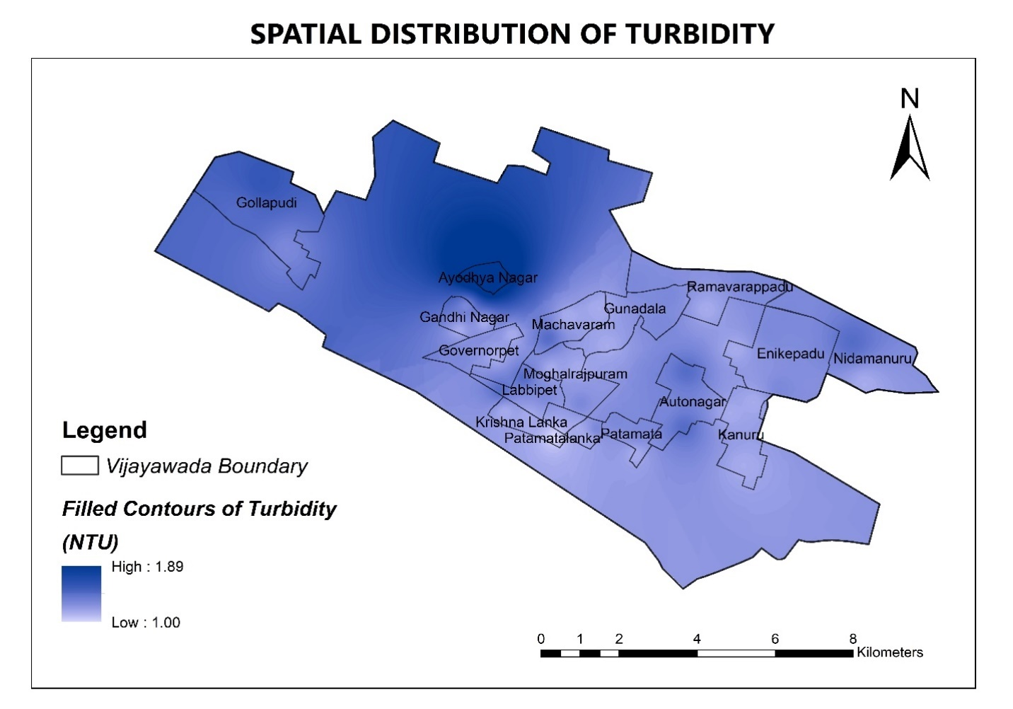
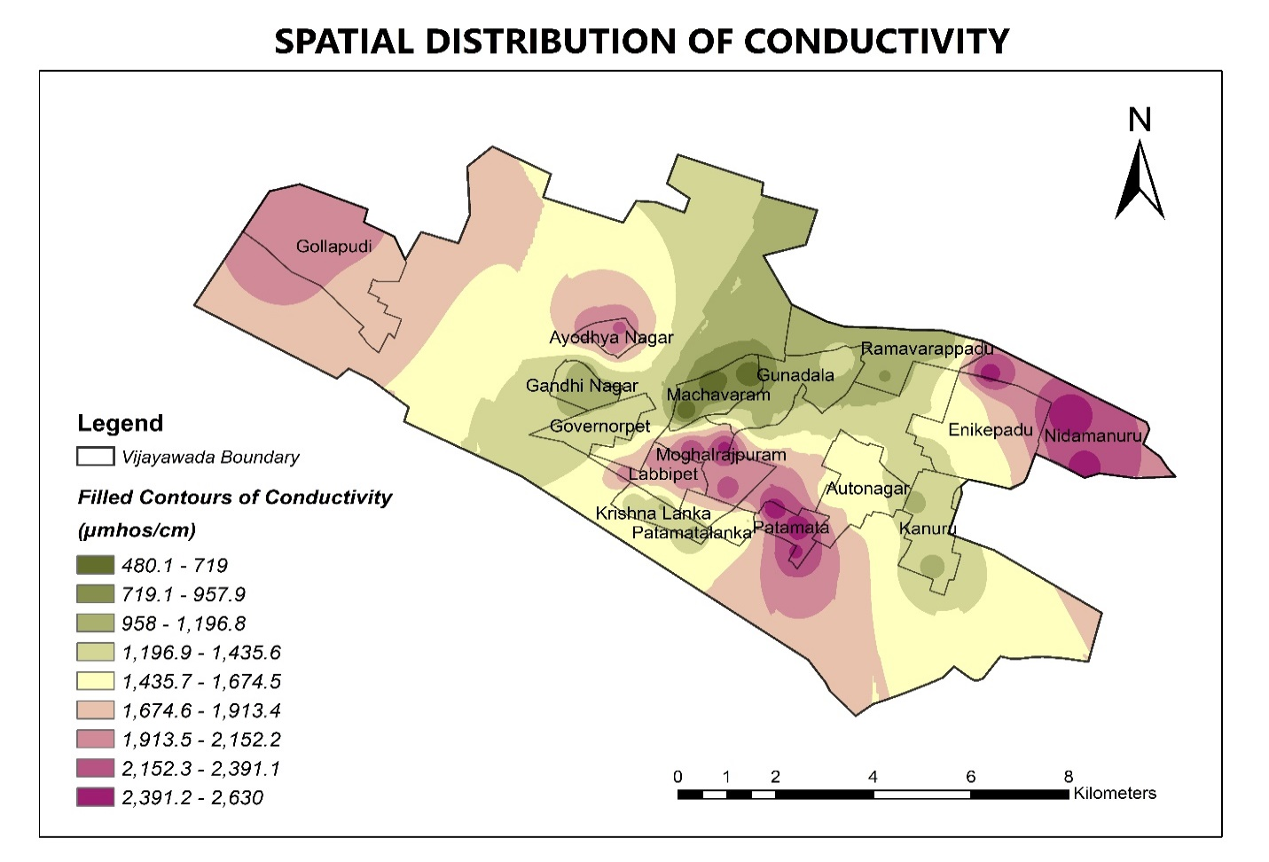

Slide 19
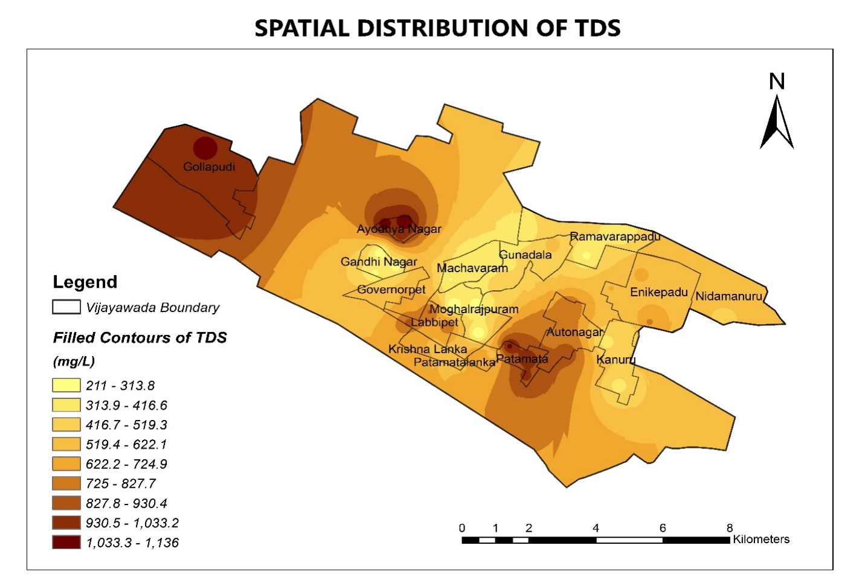
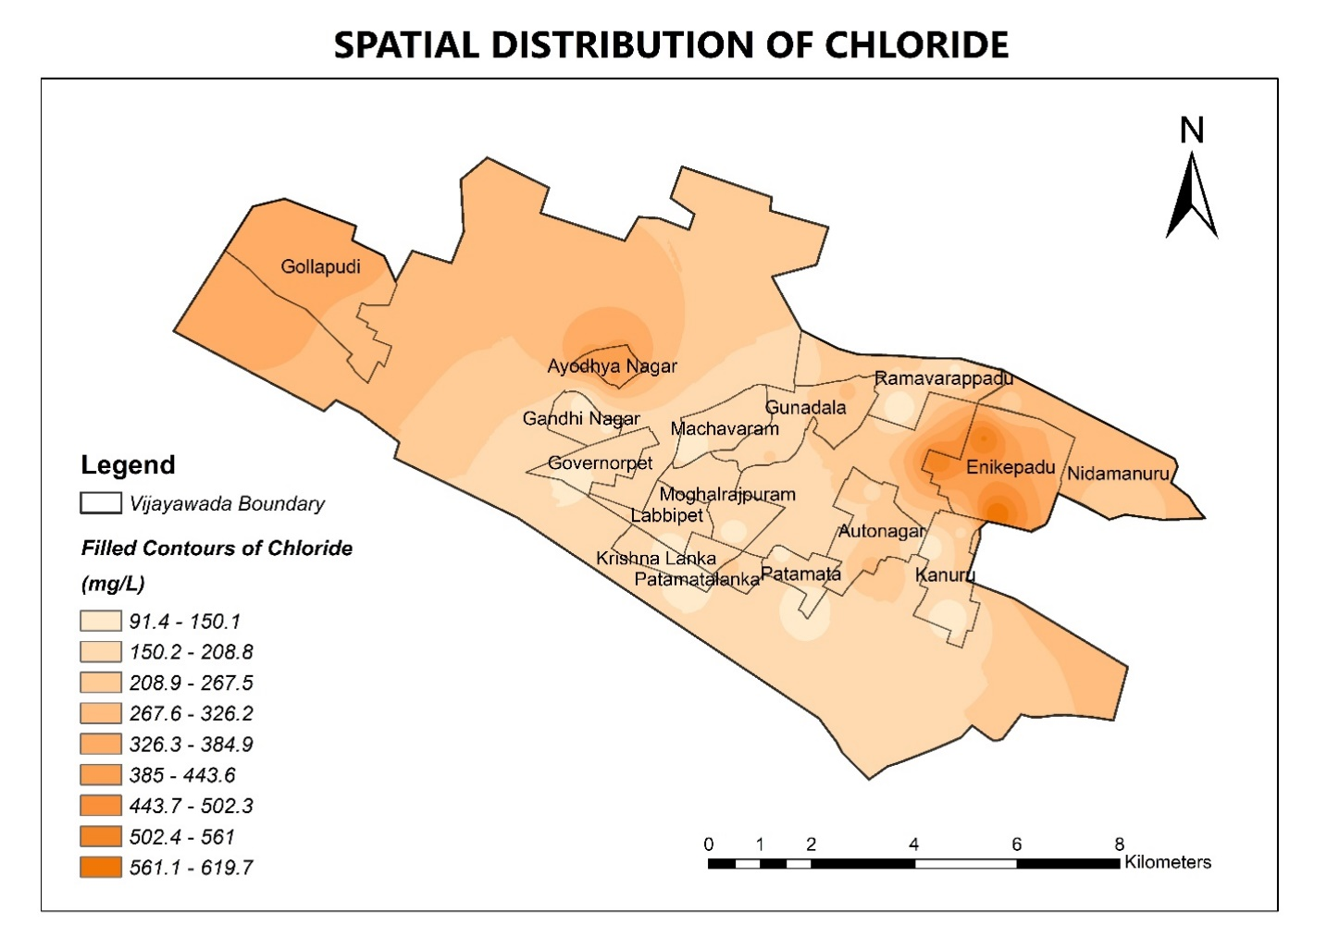

Slide 20
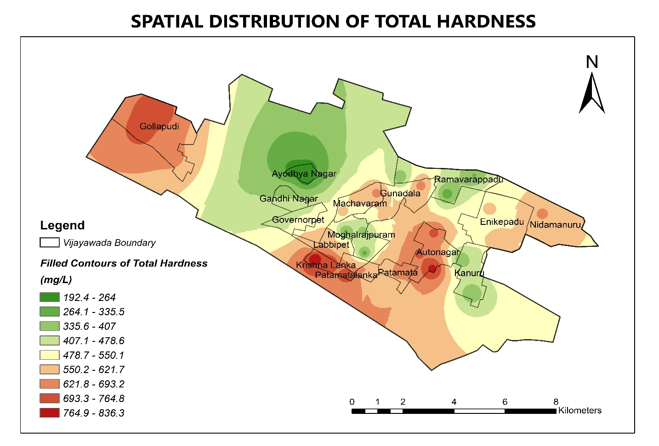
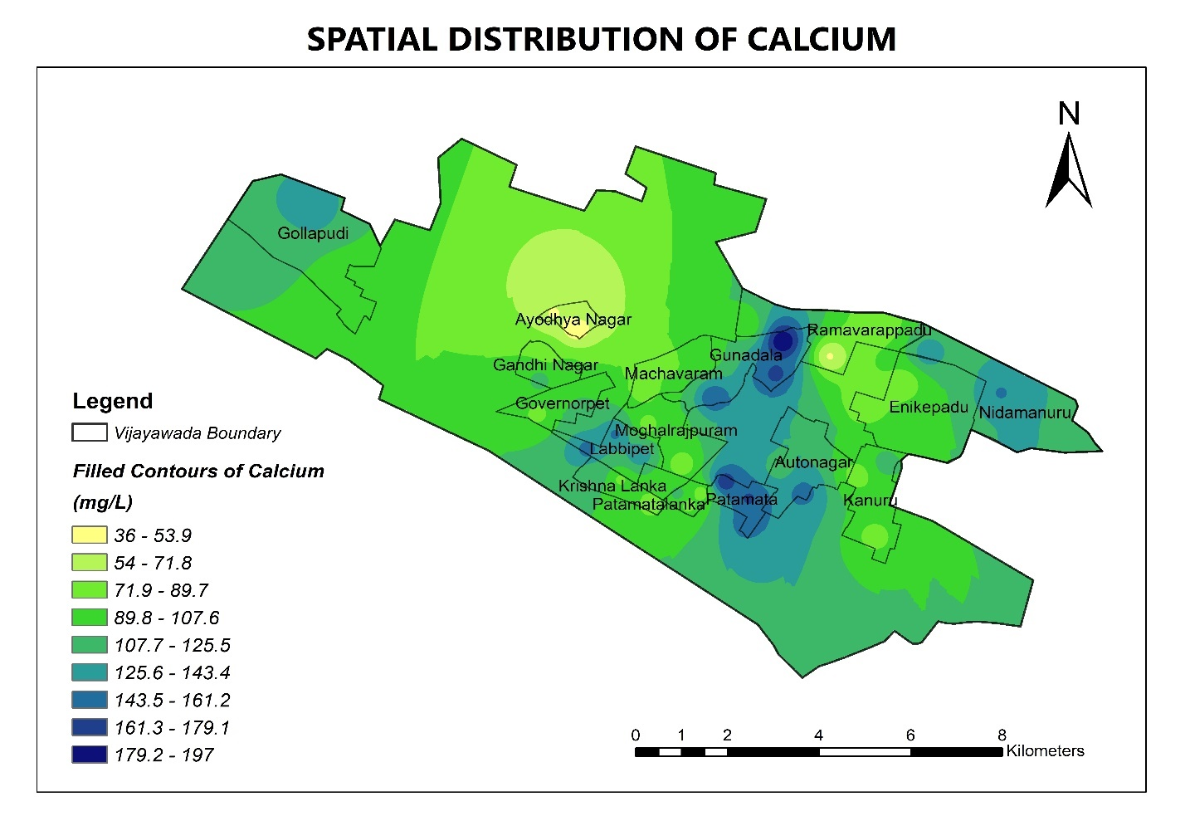

Slide 21
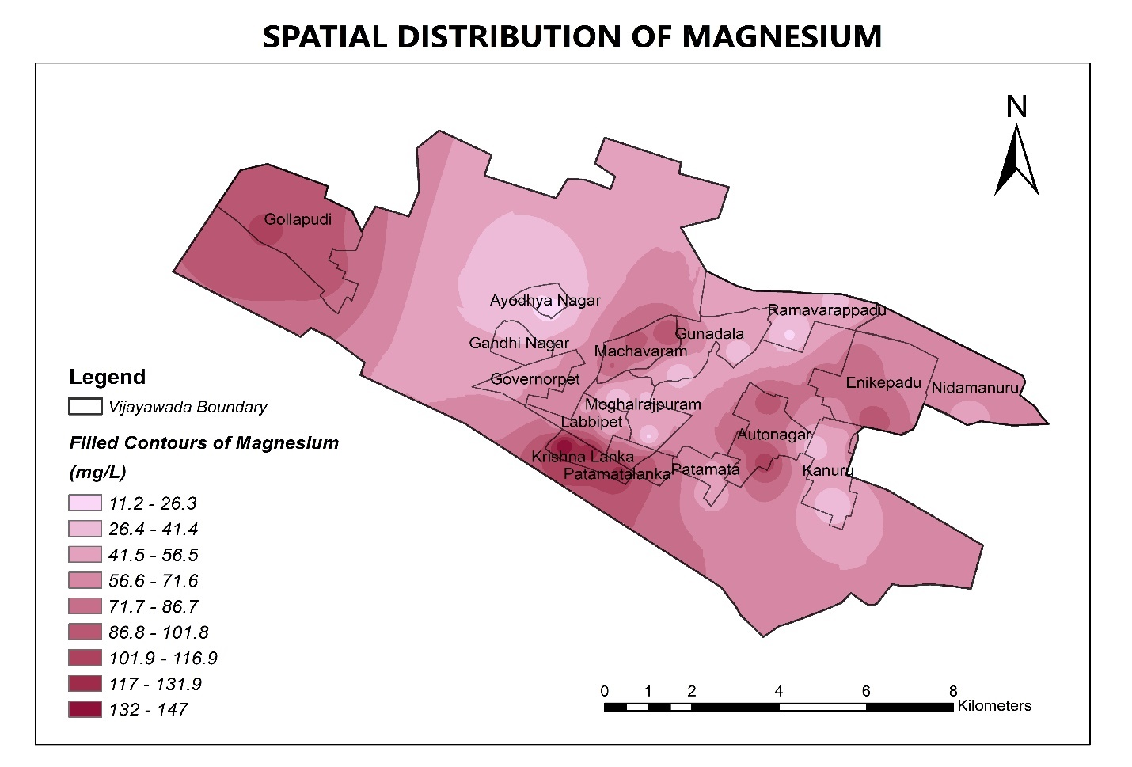
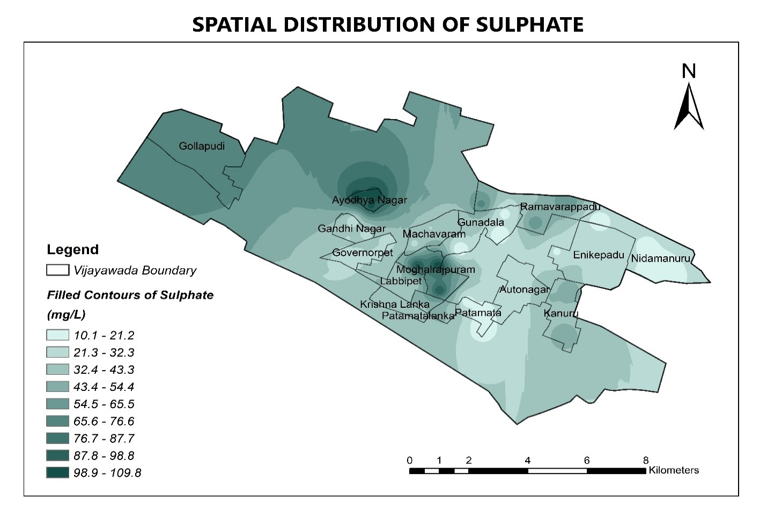

Slide 22
Conclusion
4

Slide 23
CONCLUSION
Spatial distribution maps were developed.
Remedies with unusable ground water were stated.
Gathered knowledge on the state of ground water of our Vijayawada city.
Suggestion: Ground water recharge structures should be planned.

Slide 24
THANKS!
Any questions?

